Slide 1
COMP-SCI 5551 ASE: Final Project Presentation
Brett Recker (22)
Radwan Albadawi (1)

Slide 2
A Database System for Deep Learning
Deep learning experiments provide a rich set of artifacts which include the model’s architecture, the weights of the models, a set of hyperparameters, and several other files. We were tasked with building a database system that can handle storing these artifacts, query and retrieve these artifacts in a team manner, and provide the capability to compare two or more versions in the database.

Slide 3
Project Goal
Our objective was to create a user friendly web application for uploading Deep Learning experiments and also provide users with the ability to view existing experiments from all projects. We also tried to implement functionality for comparing artifacts between two or more experiments but were unable accomplish this before the project deadline.

Slide 4














Technologies and Applications

Slide 5


Frontend
Login and Register
Metadata POST
Metadata GET
Filter Service
mongoose
multer
gridfs-storage
gridfs-stream
Angular Fire Auth
(signInWithEmailAndPassword)
(createUserWithEmailAndPassword)
User Registration and Authentication
NoSQL Database
Backend

Slide 6
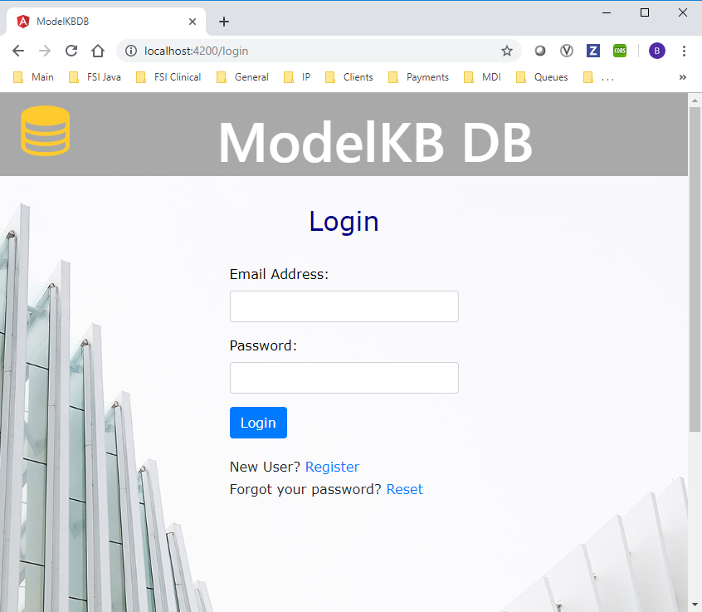
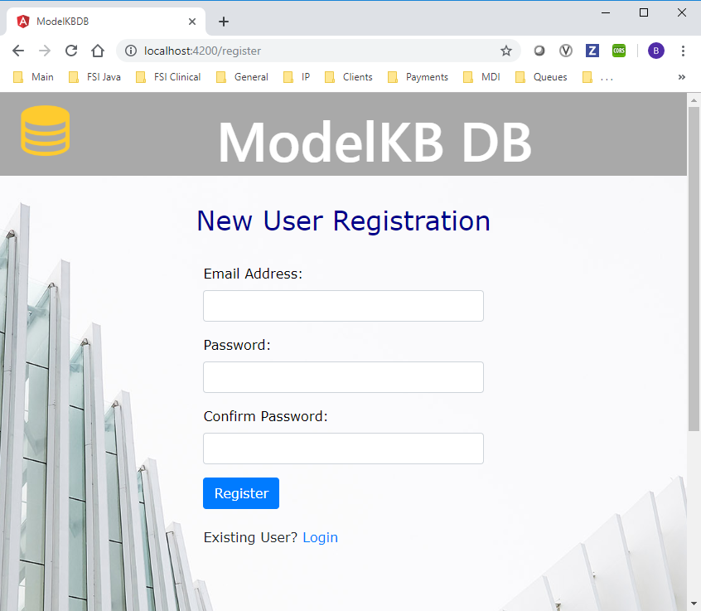
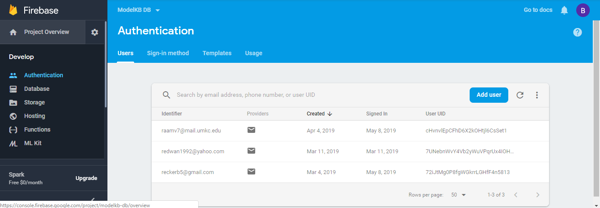

Slide 7
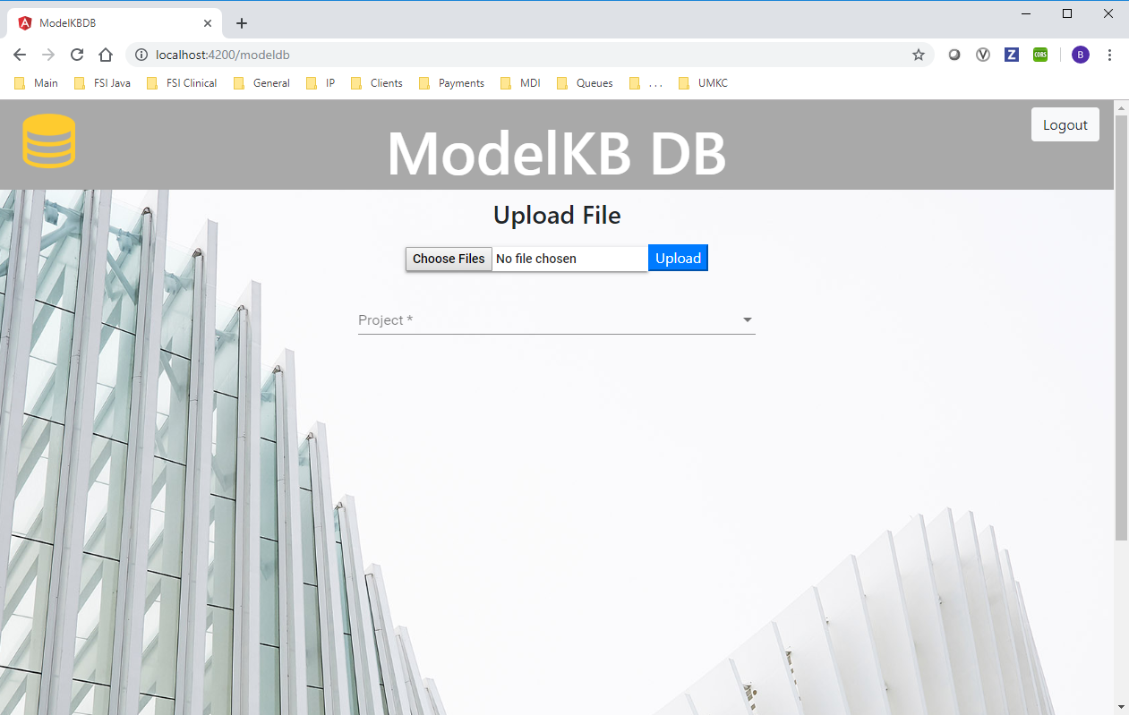

Slide 8
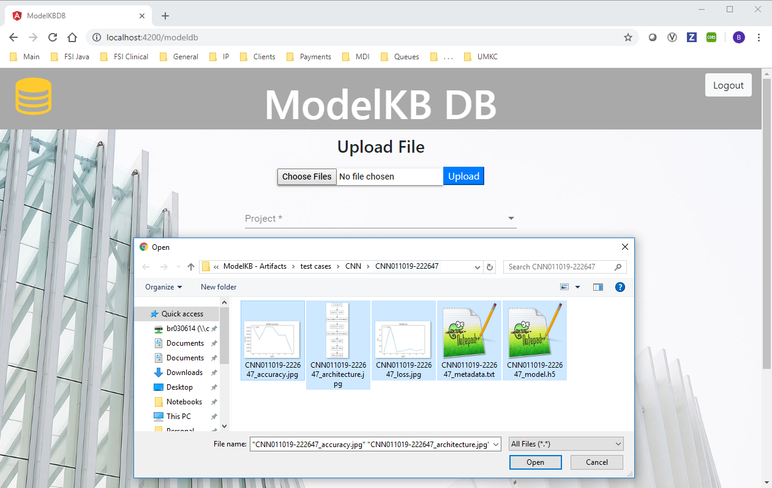

Slide 9
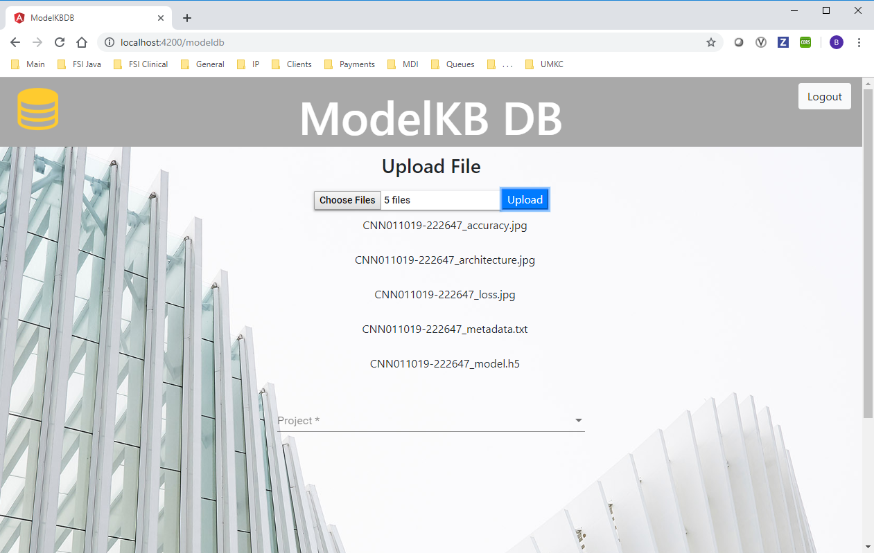
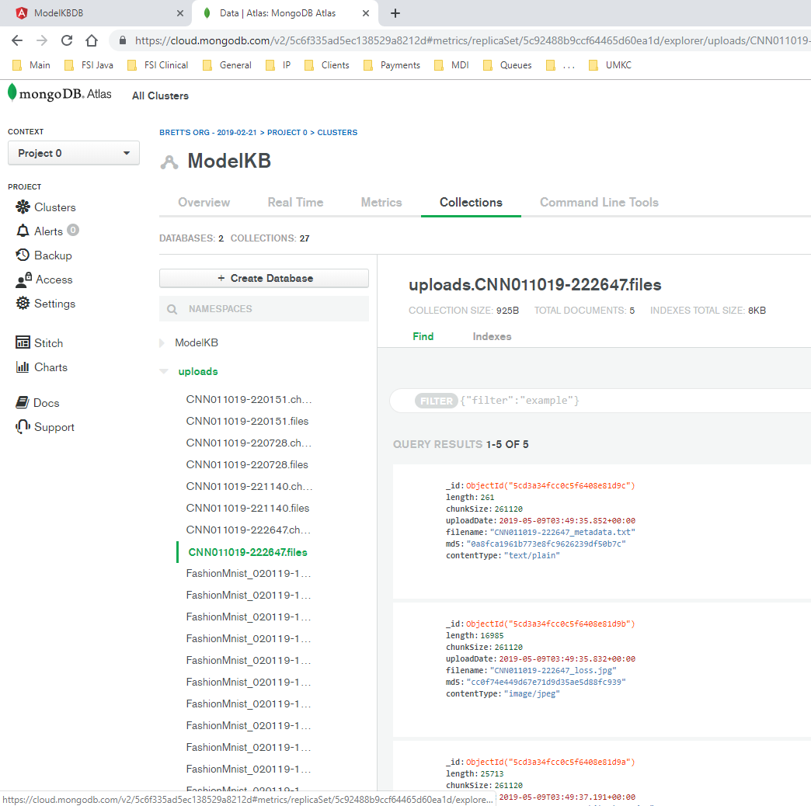

Slide 10
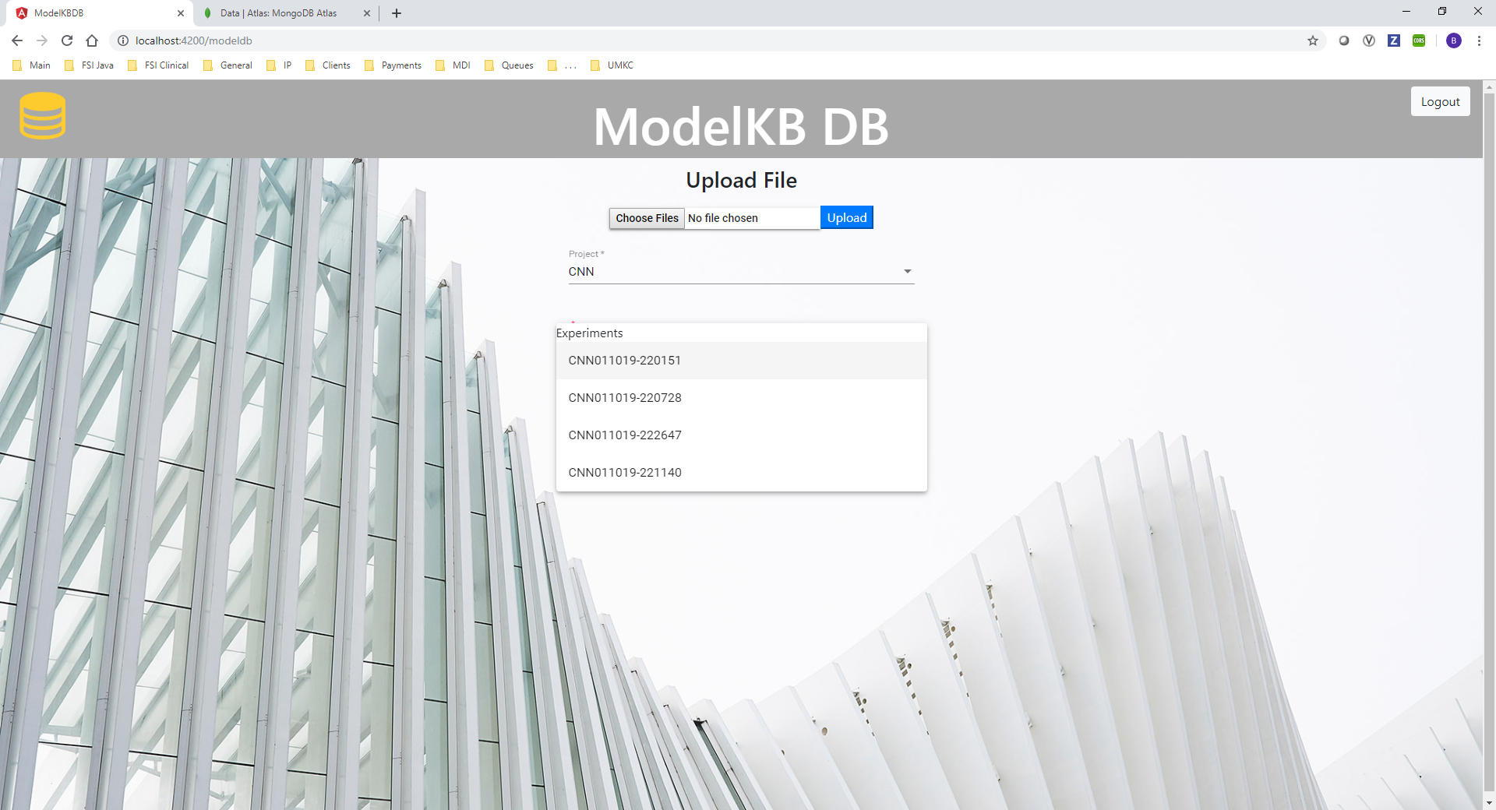
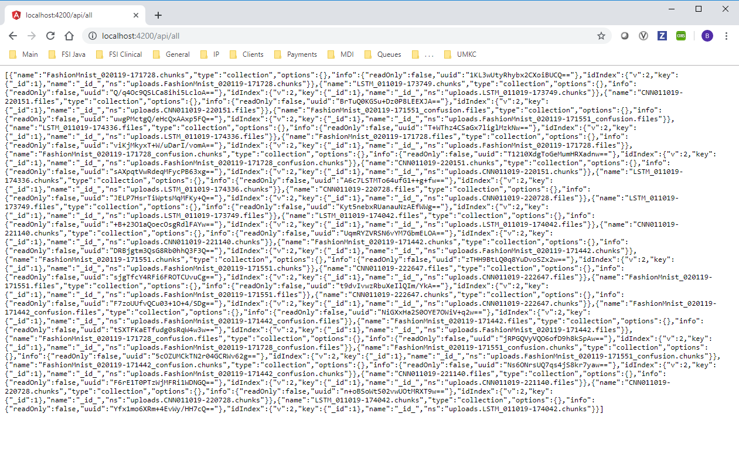

Slide 11
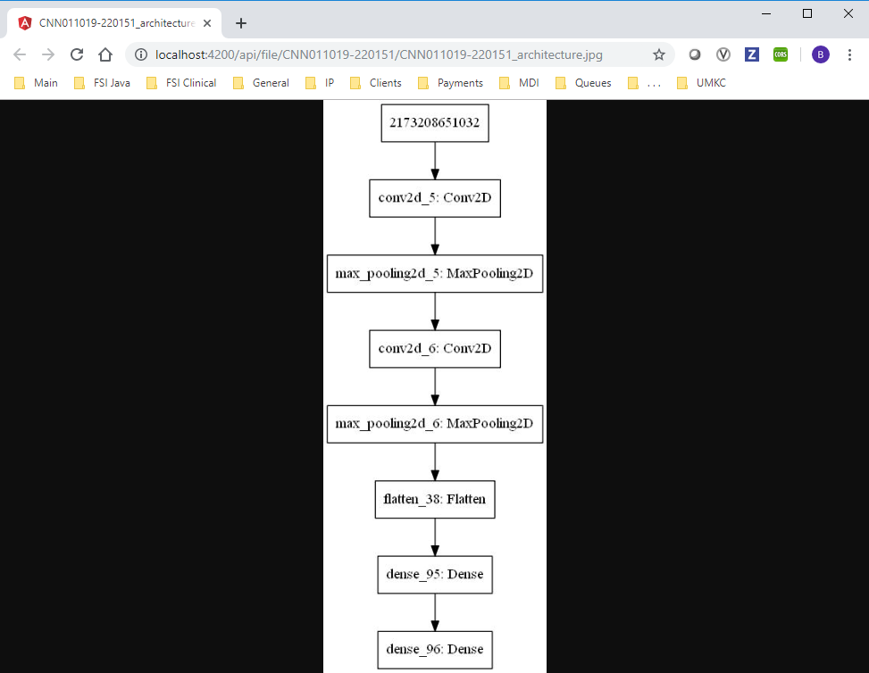
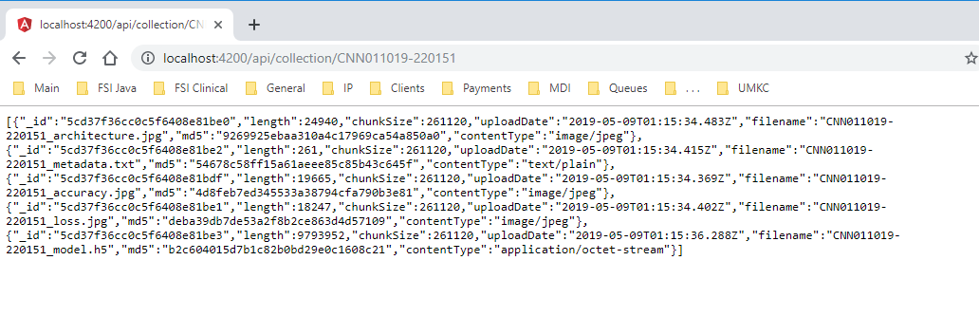
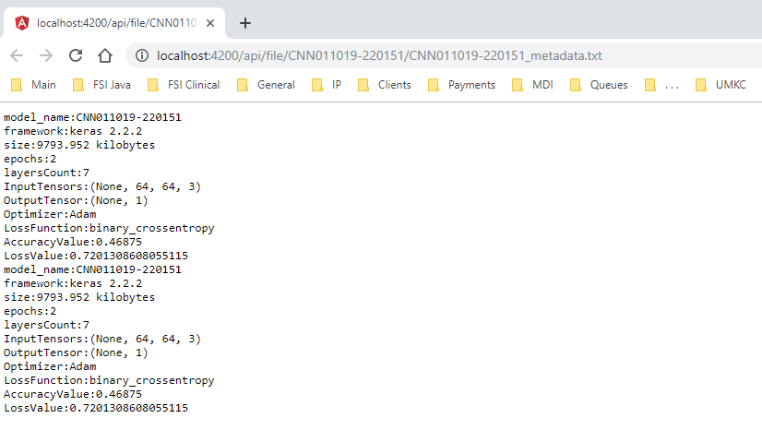

Slide 12
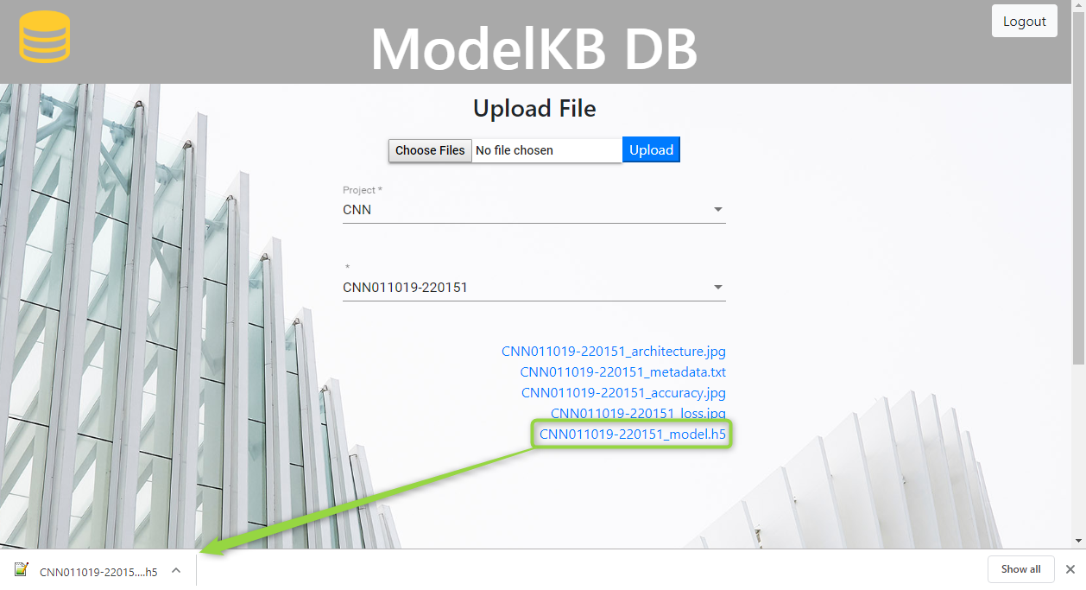
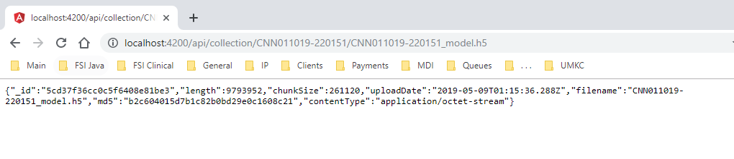

Slide 13
Questions?

